Slide 1
STOCK MARKET FORECASTING (Using Time Series Analysis)
Team Members:
Dipanshu Agarwal(N-201)
Riya Airen(N-204)
Saurabh Ajit(N-205)
Project Mentor(s):
Ms. Varsha Nemade

Slide 2
Index
Synopsis
Goal
Literature Review
Methodology
Schedule
Fundamentals of Trading
Algorithms
References

Slide 3
Synopsis
Predicting the Stock Market has been the bane and goal of investors since its existence. Everyday billions of dollars are traded on the exchange, and behind each dollar is an investor hoping to profit in one way or another. Entire companies rise and fall daily based on the behavior of the market. Should an investor be able to accurately predict market movements, it offers a tantalizing promises of wealth and influence. In the real world, the stock market predictions can be categorized in 2 parts, Fundamental Analysis and Technical Analysis.
In this undertaking, we will be creating a supervised machine learning model which will help us to somewhat predict the price value of stocks/security of a company i.e. State Bank of India to be specific. The Model will be using Time-Series Analysis, Time series is a set of observations or data points taken at specified time usually at equal intervals and it’s used to predict the future values based on the previous observed values.

Slide 4
Goal
The Chief goal of this project is to add to the academic understanding of stock market prediction.
This project will focus exclusively on predicting the daily trend (price movement) of individual stocks.
The project will also analyze the accuracies of these predictions.
We will be comparing different time-series models with their error percentage in mind.

Slide 5
Literature Review
Contreras et al. [3] used ARIMA models to predict next day electricity prices; they have found two ARIMA models to predict hourly prices in the electricity markets of Spain and California. The Spanish model needs 5 hours to predict future prices as opposed to the 2 hours needed by the Californian model.
Kumar et al. [4] used ARIMA model to forecast daily maximum surface ozone concentrations in Brunei Darussalam. They have found that ARIMA (1,0,1) was suitable for the surface 03 data collected at the airport in Brunei Darussalam.
Tsitsika et al. [5] used ARIMA model to forecast pelagic fish production. The final model selected were of the form AR[MA (1,0,1) and AR[MA (0,1,1 ).
Azad et al. [6] used ARIMA model in forecasting Exchange Rates of Bangladesh. By using Box-Jenkins methodology they tried to find out the best model for forecasting.
Debadrita Banerjee et al.[7] has collected data on the monthly closing stock indices of sensex for six years(2007-2012) and based on these she has tried to develop an appropriate model which would help her to forecast the future unobserved values of the Indian stock market indices. This study offers an application of ARIMA model based on which she predicts the future stock indices which have a strong influence on the performance of the Indian economy. To establish the model she applied the validation technique with the observed data of sensex of 2013.

Slide 6
Methodology
START
ORIGINAL DATASET
MODEL TESTING
MODEL IDENTIFICATION
ERROR CALCULATION
MODEL VISUALIZATION
MODEL BUILDING
REPEAT WITH OTHER MODEL
MODELTRAINING
END

Slide 7
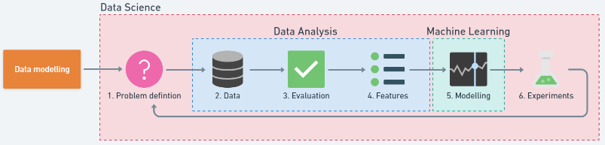
Methodology
FIGURE 1: - STEPS IN A FULL MACHINE LEARNING PROJECT ^{[1]}

Slide 8
Schedule
Study of Basics of Time-Series Analysis and Fundamentals of Trading
Collecting of Dataset and Data-set Pre-Processing & Normalization
Study of Different Time-Series Models and Selection of Model
Study of the Mathematical concepts behind the model
Creation of Model using python and various python libraries as well as studying the various functions used in the model
Training and Testing of the Model
Prediction of Stock Market Prices and Validation
Final Project Report and Submission

Slide 9
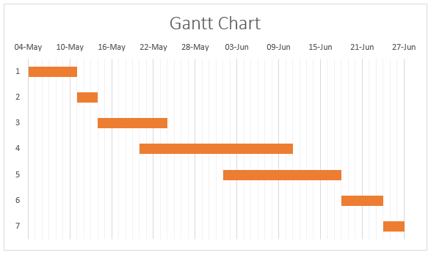
Schedule(cont.)
A time frame indicating steps that will be required and the expected date when they will be completed.

Slide 10
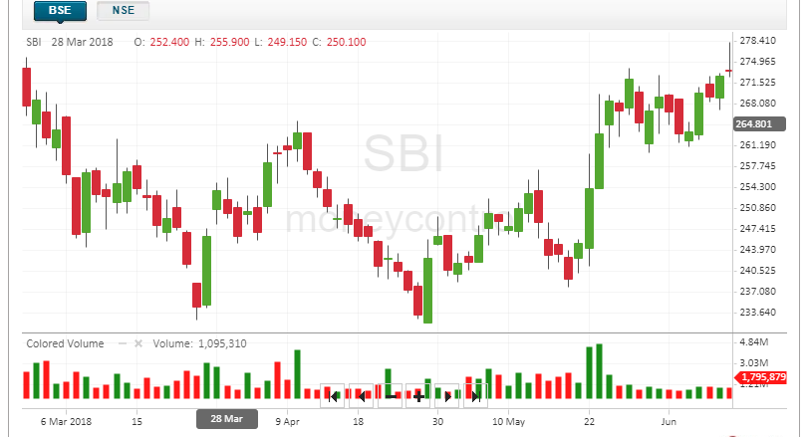
Fundamentals of Trading
In the above graph, we see a peculiar representation technique being used which is known as a candlestick, a candlestick is a type of price chart used in technical analysis that displays the high, low, open, and closing prices of a security for a specific period.

Slide 11
Fundamentals of Trading
The Color of the Bar i.e. Red or Green denotes that the stock closed on a Lower price or a Higher Price respectively on that particular day.
From the colours we can also conclude that Red or Black means there are a more number of buyers is more in the market as they will try to drive the price of security down so as to buy it at a low cost, and Green or White means that the numbers of seller of that particular security is more as they will try to drive the price higher so as to earn maximum profit on selling the security.
There is a third state which is known as a consolidated state, in which the number of buyers and sellers for a security are the same in the market. In this case, it is denoted using a simple horizontal line.

Slide 12
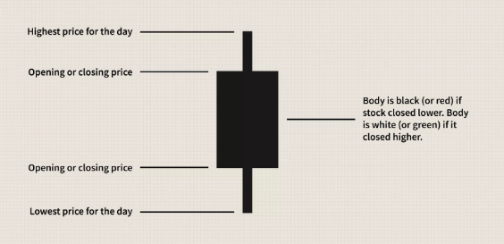
Fundamentals of Trading

Slide 13
Fundamentals of Trading
The main factors which bring about a huge change in the variance and mean of the security prices are:-
Buyer and Seller
IPO: - stand for Initial Public Offering. When the news media report that a company is "going public," this means that company is making an initial public offering. This means that the company is offering its shares for sale to the public for the first time.
Pandemics
Merger and Acquisitions: - Mergers and acquisitions are transactions in which the ownership of companies, other business organizations, or their operating units are transferred or consolidated with other entities.
Import and Export
Government Issues/Changes to Laws.

Slide 14
Time Series Analysis
Time series is simply a series of data points ordered in time. In a time series, time is often the independent variable and the goal is usually to make a forecast for the future.
The Time-Series generated may have any of the 3 properties:-
Auto-Correlation
Seasonality
Stationarity
Often Stock Prices are not a stationary process, since we might see a growing trend, or its volatility might increase over time i.e. variance is ever-changing.

Slide 15
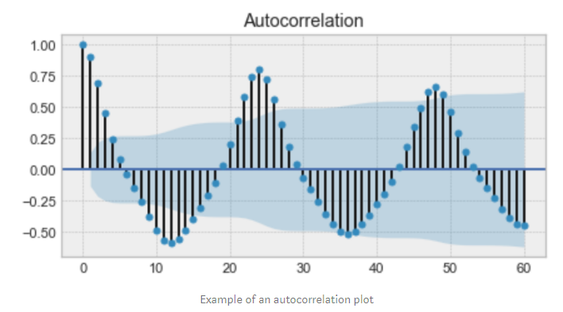
Auto-Correlation
Auto-Correlation: - is the similarity between observations as a function of the time lag between them. For example, in the graph below the first and the 24th value have a high autocorrelation similarly for the 12th and 36th value.

Slide 16
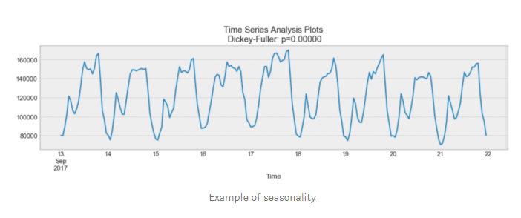
Seasonality
Seasonality: - Refers to periodic functions, for example electricity consumption is high during the day and low during night, or online sales increase during Christmas before slowing down again. Seasonality can also be derived from an Auto-Correlation Plot if it has a sinusoidal shape.

Slide 17
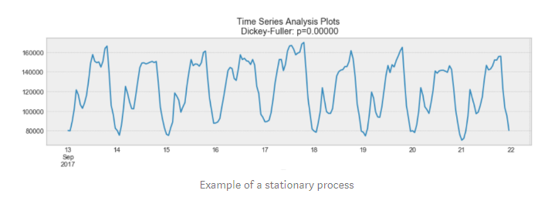
Stationarity
Stationarity: - is an important characteristic of time-series. A time-series is said to be stationary if its statistical properties do not change over time. In other words, it has constant mean and variance, and co-variance is independent of time.

Slide 18
Modelling Time series
There are many ways to model a time series in order to make predictions:
Moving Average
Linear Regression
k-Nearest Neighbors
Prophet
Auto ARIMA
Long Short Term Memory (LSTM)

Slide 19
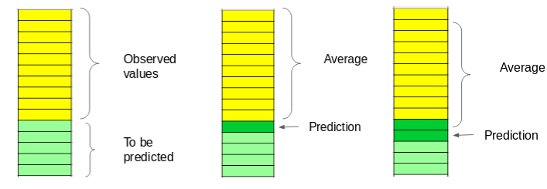
Moving Average
The moving average model is probably the most naive approach to time series modelling. This model simply states that the next observation is the mean of all past observations. We can define a window to apply the moving average model to smooth the time series, and highlight different trends.

Slide 20
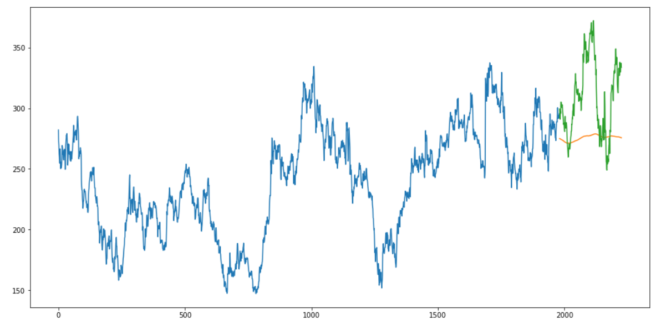
mape value - 44.46
rmse value – 33.33

Slide 21
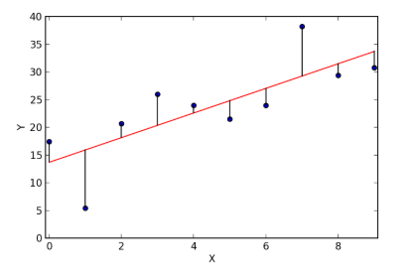
Linear Regression
The most basic machine learning algorithm that can be implemented on this data is linear regression. The linear regression model returns an equation that determines the relationship between the independent variables and the dependent variable.
EXAMPLE OF A LINEAR REGRESSION

Slide 22
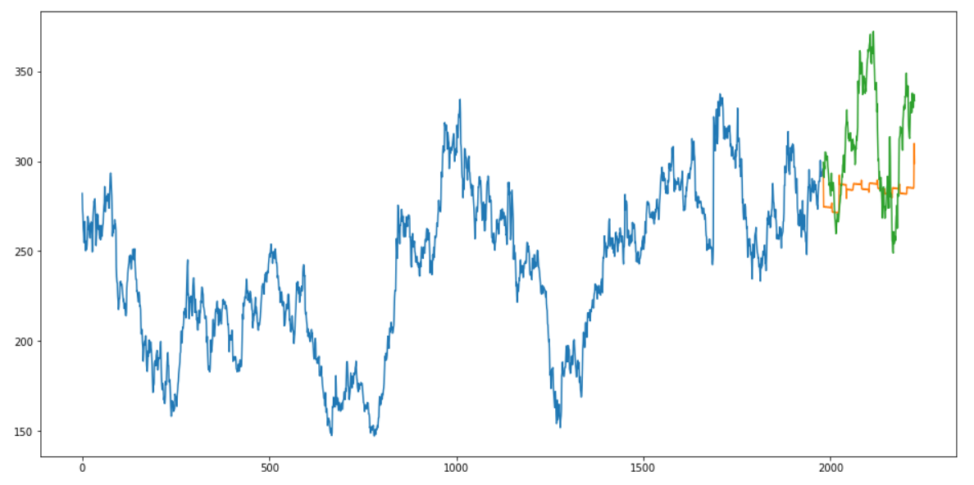
mape value – 25.72
rmse value – 38.43

Slide 23
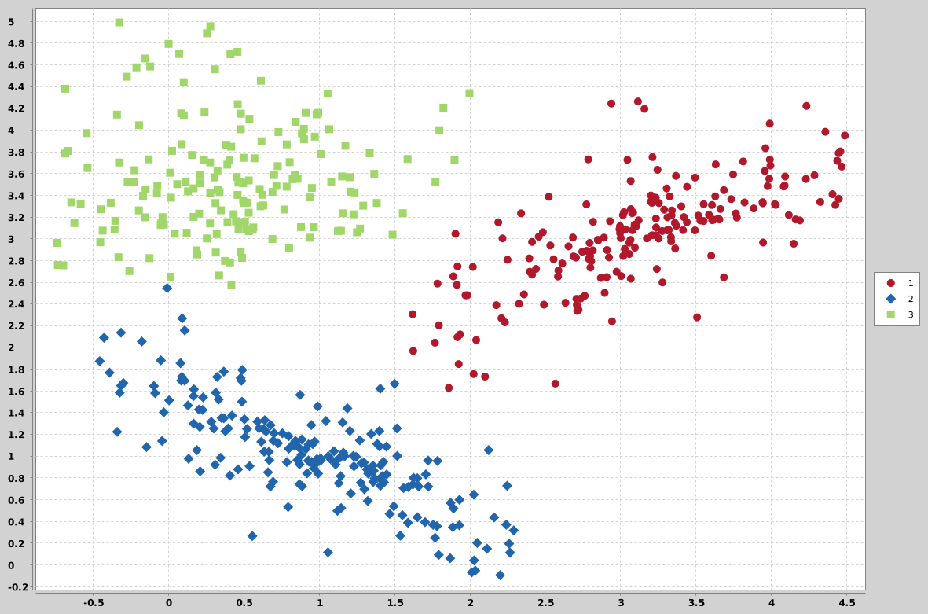
K-Nearest Neighbours
Another interesting ML algorithm that one can use here is kNN (k nearest Neighbours). Based on the independent variables, kNN finds the similarity between new data points and old data points.
EXAMPLE OF K-Nearest Neighbors

Slide 24
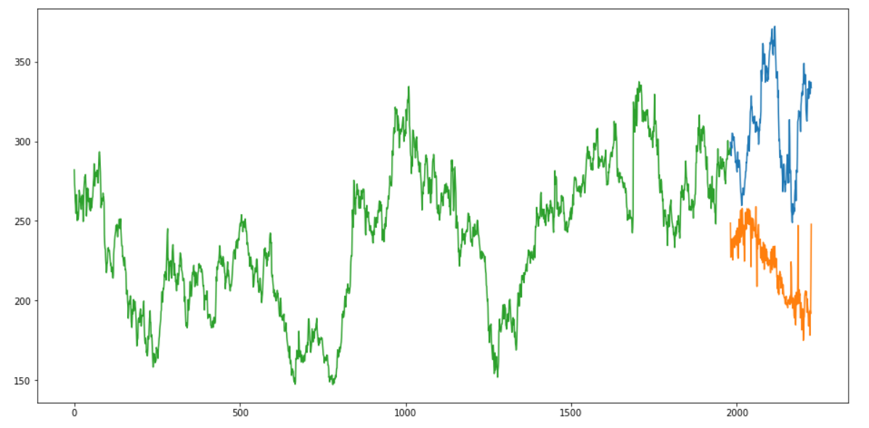
mape value – 87.08
rmse value – 94.68

Slide 25
Prophet
There are a number of time series techniques that can be implemented on the stock prediction dataset, but most of these techniques require a lot of data preprocessing before fitting the model. Prophet, designed and pioneered by Facebook, is a time series forecasting library that requires no data preprocessing and is extremely simple to implement. The input for Prophet is a dataframe with two columns: date and target (ds and y).
Prophet tries to capture the seasonality in the past data and works well when the dataset is large.

Slide 26
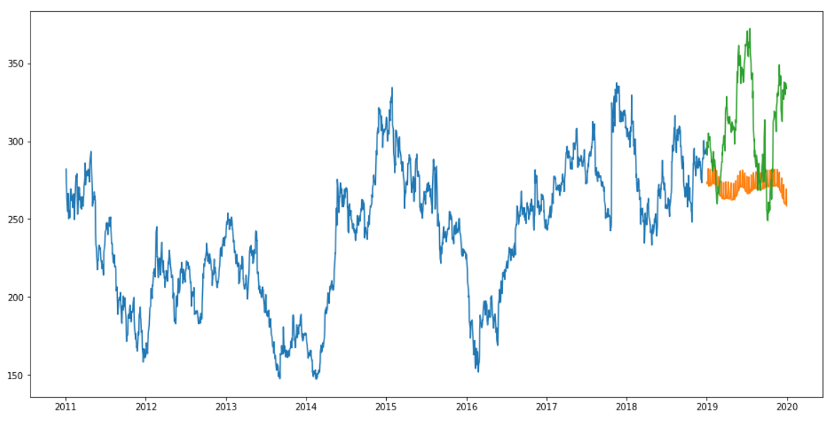
mape value – 39.03
rmse value – 50.32

Slide 27
Auto-Arima
ARIMA is a very popular statistical method for time series forecasting. ARIMA models take into account the past values to predict the future values. There are three important parameters in ARIMA:
p (past values used for forecasting the next value)
q (past forecast errors used to predict the future values)
d (order of differencing)
Parameter tuning for ARIMA consumes a lot of time. So we will use auto ARIMA which automatically selects the best combination of (p,q,d) that provides the least error.

Slide 28
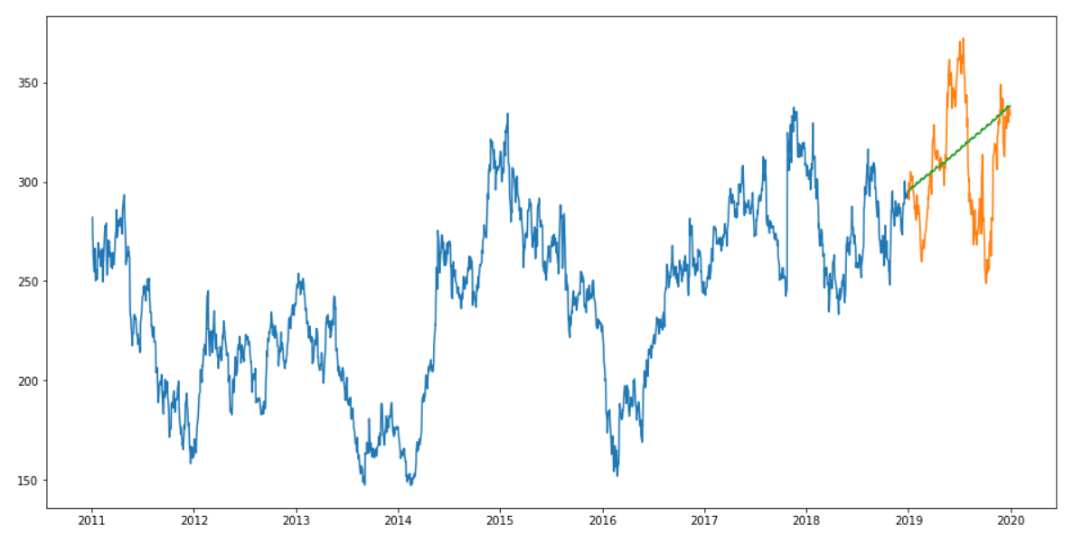
mape value – 7.35
rmse value – 31.84

Slide 29
LSTM
Long Short Term Memory (LSTM) are widely used for sequence prediction problems and have proven to be extremely effective. The reason they work so well is because LSTM is able to store past information that is important, and forget the information that is not.
LSTM has three gates:
The input gate: The input gate adds information to the cell state
The forget gate: It removes the information that is no longer required by the model
The output gate: Output Gate at LSTM selects the information to be shown as output

Slide 30
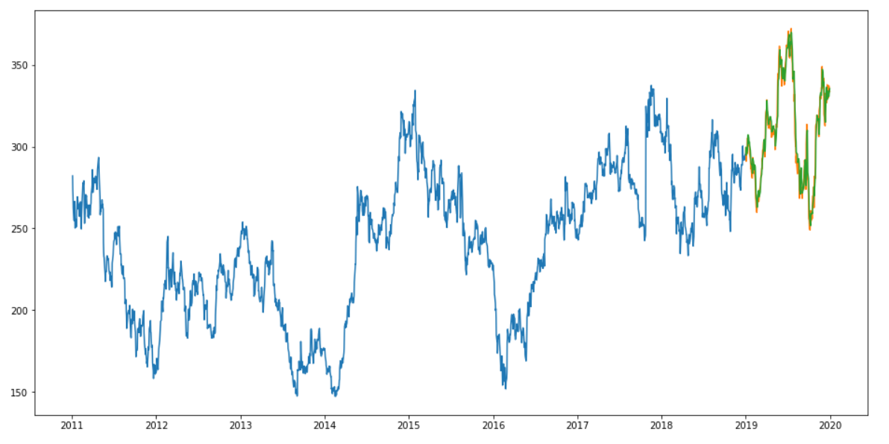
mape value - 1.09
rmse value – 7.35

Slide 31
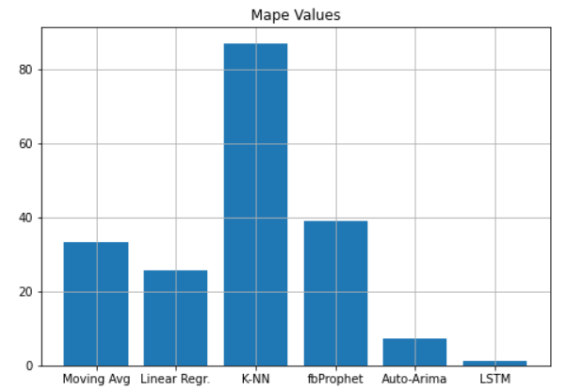
Comparison of mape values

Slide 32
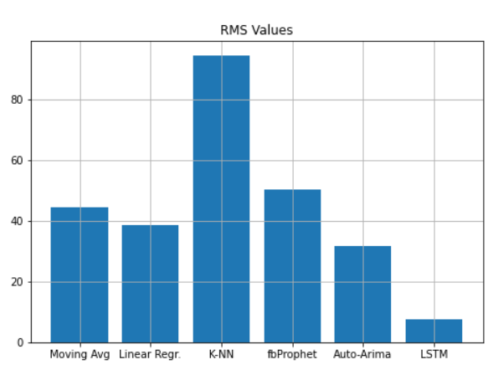
Comparison of rms values

Slide 33
References
A 6 Step Field Guide for Building Machine Learning Projects by Daniel Bourke
Introduction to Time Series Forecasting With Python by Jason Brownlee
Contreras, 1. Espinola, R.NogaJes, F1.and conejo,AJ.(2003) "ARIMA models to predict next day electricity prices", IFEE transactions on power system, vo1.18, noJ,pp: I 014-1 020.
Kumar; K Yadav;A.KSingh, M.P; Hassan and H.Jain,V.K(2004)"Forecasting Daily Maximum Surface Ozone".
Tsitsika,E.V;Maravelias,C.D& Haralatous,J. (2007)"Modelling and forecasting pelagic fish production using univariate and multivariate ARIMA models". Fisheries science volume 73,pp:979-988.
Datta K.(2011)"ARIMA forecasting of Inflation in the Bangladesh Economy",The IUP journal of bank management,voI.X,No.4,pp-7-15.
D. Banerjee, "Forecasting of Indian stock market using time-series ARIMA model," 2014 2nd International Conference on Business and Information Management (ICBIM), Durgapur, 2014, pp. 131-135, doi: 10.1109/ICBIM.2014.6970973.
“Introduction to Time Series Analysis and Forecasting” by Douglas C. Montgomery, Cheryl L. Jennings, and Murat Kulahci
“Time Series Analysis: Forecasting and Control” by George E. P. Box, Gwilym M. Jenkins, Gregory C. Reinsel, and Greta M. Ljung
Chris Chatfield, "The analysis of time series An introduction"

Slide 34
Thank you

